Slide 1
Group 4
Bethany Cowle, Caleb Guppy, Victor Sicoe, Ben Carter

Slide 2
Brief
2D Game
Main control mechanic is a simple tap
Multiplayer – by taking turns
On a single device
Symmetric
Simple and intuitive rules

Slide 3
Target Demographic & Psychographic
Casual gamers
Simple mechanics, easy to learn/master
Little skill involved
13 – 20 year olds

Slide 4
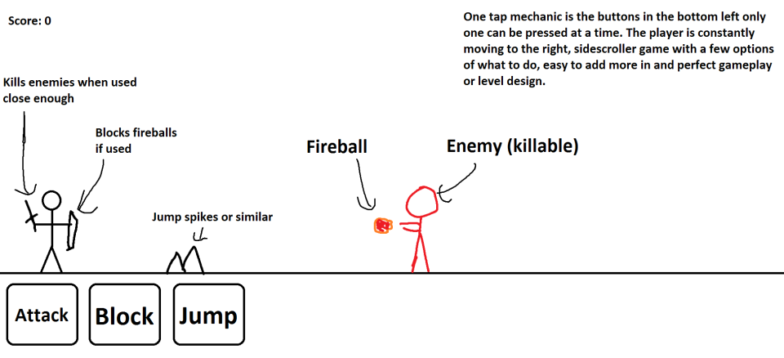
Gameplay Mechanics
Turn Based
3 Buttons
1 Tap
RPG/adventure

Slide 5
Gameplay
Fast paced
Visually flowing
Void of delays
Engaging

Slide 6
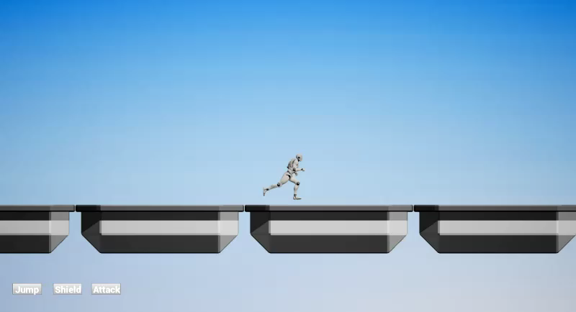
How our game meets the brief?
Jumping

Slide 7
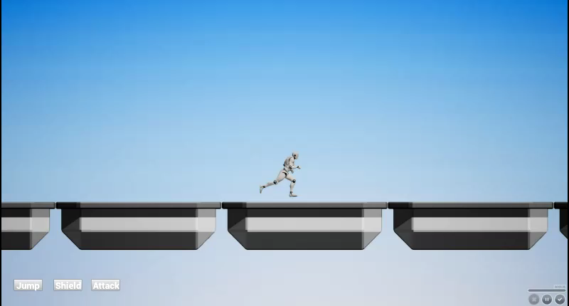
How our game meets the brief?
Shield

Slide 8
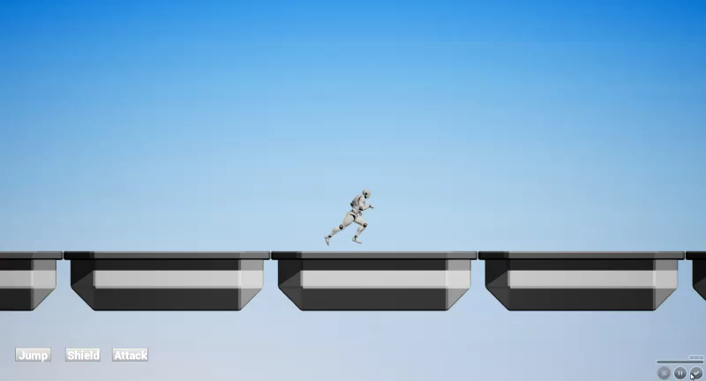
How our games meets the brief?
Shooting

Slide 9


Mood-Boards

Slide 10
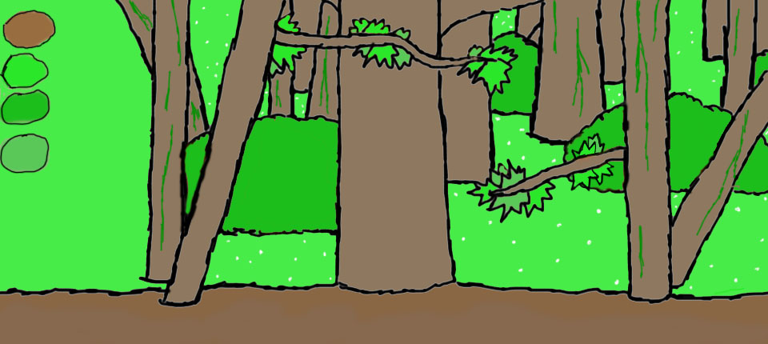
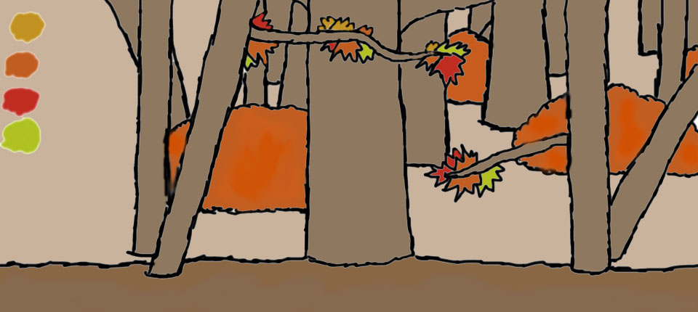

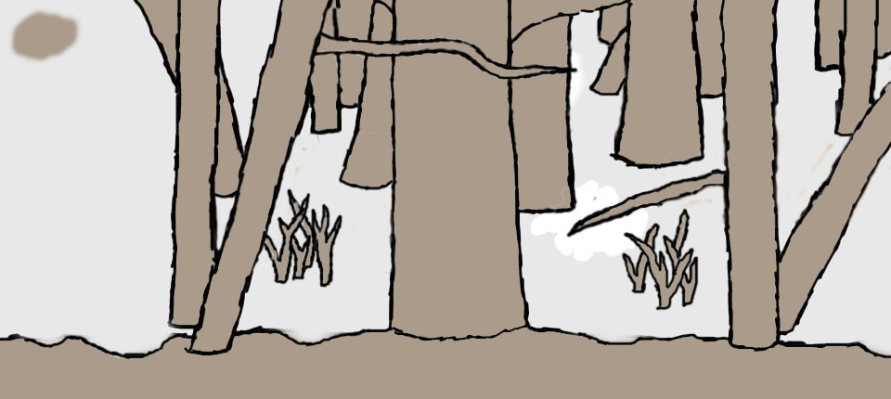
Art Style

Slide 11
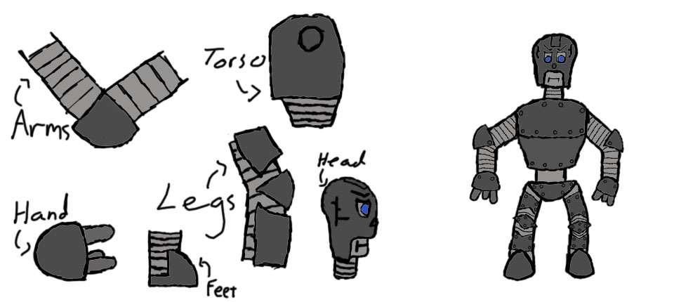
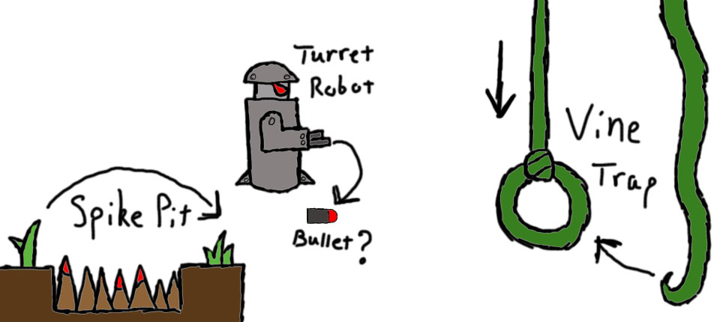
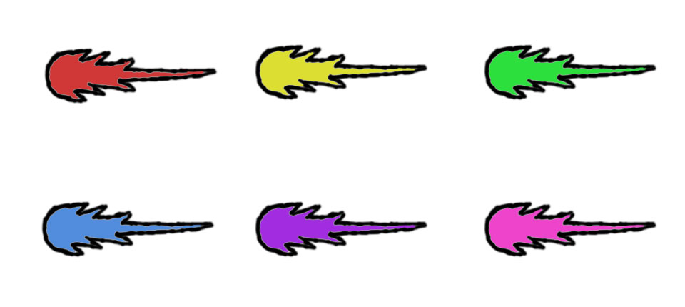
Art Style

Slide 12
Questions?

